Slide 1
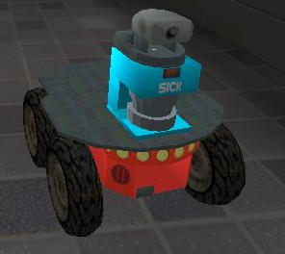
Mobile Robots I Final
Robert Borzellieri
Jasen Carroll
Swati Maini

Slide 2
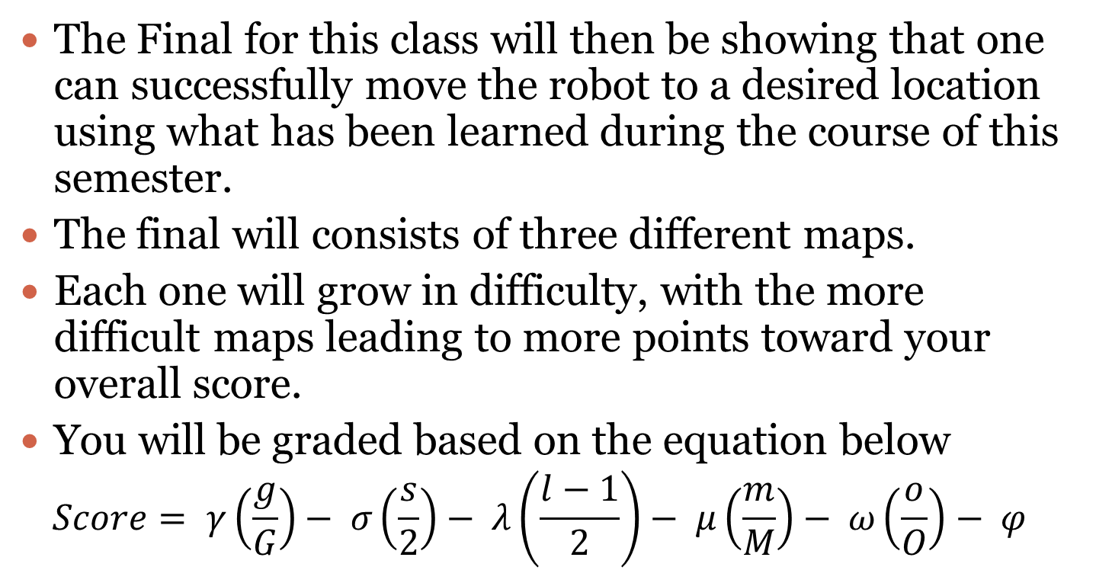
Intro
The Final for this class will then be showing that one can successfully move the robot to a desired location using what has been learned during the course of this semester.
The final will consists of three different maps.
Each one will grow in difficulty, with the more difficult maps leading to more points toward your overall score.
You will be graded based on the equation below
$$Score= γ\left(\frac{g}{G}\right)− σ\left(\frac{s}{2}\right)− λ\left(\frac{l−1}{2}\right)− μ\left(\frac{m}{M}\right)− ω\left(\frac{o}{O}\right)− φ$$

Slide 3
Problem Statement
Using Unreal Tournament 2004, USARSim and what has been taught throughout the course, get a P2AT robot to successfully navigate a maze and achieve various goal positions from unknown starting locations. As the grading equation suggests… hit all goals, use the minimum number of sensors and avoid doors, obstacles and immobilizing your robot to maximize your score.

Slide 4
Approach 1
A*
Variance of TBUG(Bug1) used for obstacle avoidance
Pause used to ensure no doors would be struck
Robot fed back vector and told that was its velocity

Slide 5
Approach 2
Potential Field
Target treated as a low value and all obstacles were treated as a relative infinity with the start position being higher than the goal as well
Gradients are used to determine direction
Line fitting used for obstacle avoidance
Circles = barrels
Doors were found using the laser range finder

Slide 6
Winning Approach
Potential Field will be used for the Final
Ran out of time developing A*
Relied too much on the accuracy of the .txt map files, would have needed a higher resolution .txt file for accuracy
TBUG approach was not implemented correctly, neither was door avoidance
Alternative: Map updating was too finicky
Most importantly, Potential Field is much more robust compared to A*

